Slide 1

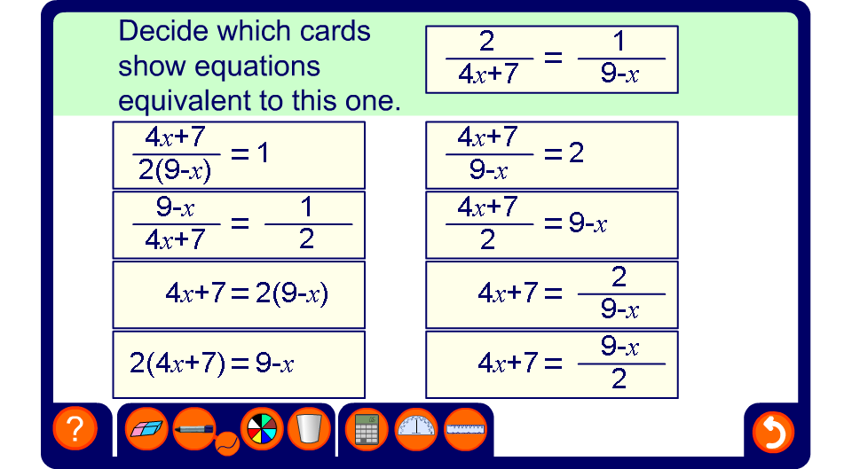


Equivalent equations
Notes:
Ask pupils to tell you which equations they believe to be equivalent to the one in the question.
Clicking on an expression will reveal whether of not it is equivalent to the required expression. Each time an equivalent expression is found ask pupils to tell you what has been done to both sides of the equation to make the selected equivalent expression.
Ask pupils to tell you which form of the equation is the easiest to solve (the form with no denominators).
Ask pupils to solve the equation in the window and substitute this solution into the equivalent equations found to verify the solution.

